Slide 1




Java Bootcamp 2018
Class 8:

Slide 2
Java Bootcamp 2018 - Class 8: Testing
The Testing
pyramid
These tests are the subset of acceptance tests that cannot be run in an automated fashion. They are designed and manually run by QA in a test environment.
Acceptance
Manual
These tests are designed by QA and written in conjunction between QA and developers. They verify in an automated way that the application as a whole is working as expected.
Acceptance Automated
These tests verify that two or more units work together correctly.
As with unit tests, integration tests are written by developers.
Integration tests
Written by developers, these tests check that each unit (class, module, etc) in isolation works as expected. This tests should cover at least 80% of the code.
Unit tests (>80% coverage)

Slide 3
Java Bootcamp 2018 - Class 8: Testing
Unit Testing
What is a unit test?

Slide 4
Java Bootcamp 2018 - Class 8: Testing
Unit Test - What is it?
A piece of code (usually a method) that invokes another piece of code
Check the correctness of some assumptions afterward
If the assumptions turn to be wrong, the unit test has failed
What is a unit?
A method or a function

Slide 5
Java Bootcamp 2018 - Class 8: Testing
Unit Testing - Importance
People who try to test their code either give up at some point or don’t actually perform unit tests
Instead, they
rely on system and integration tests to be performed much later in the product lifecycle
manually test the code via custom test applications or by using the end product they’re developing to invoke their code
That’s either too late to correct the error or very difficult to do so

Slide 6
Java Bootcamp 2018 - Class 8: Testing
Unit Testing
A Unit test should have the following properties
It should be automated and repeatable
It should be easy to implement
Once it’s written, it should remain for future use
Anyone should be able to run it
It should run at the push of a button
It should run quickly
It is fully automated, trustworthy, readable and maintainable

Slide 7
Java Bootcamp 2018 - Class 8: Testing
Unit Testing Framework
Unit tests are almost always written using a unit-test framework (e.g. JUnit)
Unit-testing frameworks are code libraries and modules that help developers unit-test their code, as outlined in the following table

Slide 8
Java Bootcamp 2018 - Class 8: Testing
The xUnit Framework
There are more than 150 unit-testing frameworks
Practically one for every programming language in public use
called the xUnit frameworks, because their names usually start with the first letter of the language for which they were built.

Slide 9
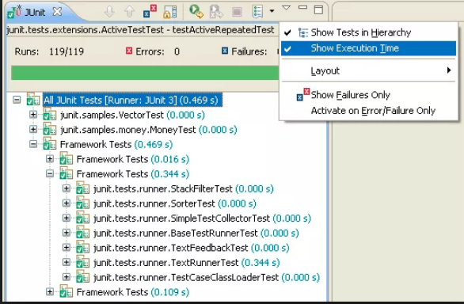
Java Bootcamp 2018 - Class 8: Testing
Unit Testing in Java
The commonly used framework for unit testing in Java is JUnit
It is an integrated part of the Eclipse IDE/IntelliJ
<dependency>
<groupId>junit</groupId>
<artifactId>junit</artifactId>
<version>4.12</version>
<scope>test</scope>
</dependency>

Slide 10
Java Bootcamp 2018 - Class 8: Testing
JUnit naming conventions
Test case class: named [className]Test.java, where className is the name of the class being tested
Test case method: named test[methodName], where methodName is the name of the method being tested

Slide 11
Java Bootcamp 2018 - Class 8: Testing
Unit Testing in Java
JUnit provides us with several ways to judge if a test has succeeded or failed. Our TestCase object that we have extends Assert which provides the following functionality for testing.
Classes being tested should be in the same package than the original class (allowing access to protected vars), under src/test

Slide 12
Java Bootcamp 2018 - Class 8: Testing
Unit Testing in Java
assertEquals: This provides a series of overloads that allows you to test if an actual value matches the expected one.
assertFalse: Use this if you know the function will always return false (fails if it receives true)
assertNotNull: If your method return null in the event of failure use this to check to see if it succeeds
assertNotSame: If your method is supposed to return an element from a list you can use this to check if the element returned is the one from the actual list
assertNull: If your method return null in the event of failure use this to check to see if it fails
fail: Will fail the test, use this in conjunction with conditionals
failNotEquals: Essentially the same as assertEquals but will fail the test if they arent equal instead of causing an error
failNotSame: Essentially the same as assertNotSame except instead of causing an error it will cause a failure

Slide 13
Java Bootcamp 2018 - Class 8: Testing
JUnit Test Case
Defined as a public method with zero arguments and returns nothing (void)
Decorated with @Test annotation
Must contain at least an assert statement to evaluate the results of the execution of a method
Must contain relevant assert statements to evaluate if the method behaves as expected

Slide 14
Java Bootcamp 2018 - Class 8: Testing
JUnit Annotations
@Test: Defines a single test case to execute.
@Ignore: Allows to ignore a test case.
@Before: Allows executing a method before executing each test case. This is useful to prepare classes and resources to be used in the test.
@After: Allows executing a method after executing each test case. This is useful to free resources used in the tests like closing files or streams.
@BeforeClass: Allows executing a method once before executing all test cases. This method should be static.
@AfterClass: Allows executing a method once after executing all test cases. This method should be static.

Slide 15
Java Bootcamp 2018 - Class 8: Testing
Unit Testing in Java
Each test method is marked with @Test annotation
package com.example.services;
public class FlightServiceTest {
private FlightService flightService;
@Test
public void testAddFlight(){
….
}

Slide 16
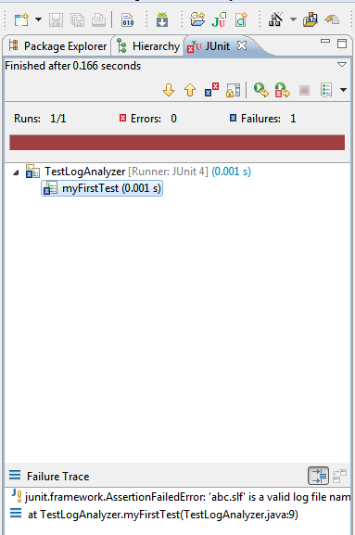
Java Bootcamp 2018 - Class 8: Testing
Unit Testing in Java
The test will be failed (red line in JUnit tab)
After fixing the problem in the source code,
will get a green line

Slide 17
Java Bootcamp 2018 - Class 8: Testing
Mocking
What is a Mock?
When should I use a mock?

Slide 18
Java Bootcamp 2018 - Class 8: Testing
Mocking - When to mock
public class FlightRestController {
private FlightService flightService;
public Flight addFlight(Flight flight){
this.checkFlight(flight);
flightService.addFlight(flight);
}
public int getFlightService(){
return this.flightService;
}
}
public class FlightRestControllerTest {
@TestSubject
FlightRestController flightRestController = new FlightRestController();
@Test
public void testAddFlight(){
Flight flight = new Flight(“bsas”, “madrid”);
flightRestController.addFlight(flight);
}
}

Slide 19
Java Bootcamp 2018 - Class 8: Testing
Mocking - What is a mock?
Dummy implementation for an interface or a class in which you define the output of certain method calls.
Configured to perform a certain behavior during a test
Record the interaction with the system and tests can validate that
EasyMock and Mockito for Java
<dependency>
<groupId>org.easymock</groupId>
<artifactId>easymock</artifactId>
<version>3.6</version>
<scope>test</scope>
</dependency>

Slide 20
Java Bootcamp 2018 - Class 8: Testing
Mocking - In action
public class FlightRestController {
private FlightService flightService;
public Flight addFlight(Flight flight){
this.checkFlight(flight);
Flight result = flightService.addFlight(flight);
return FlightDTO.toDTO(result);
}
public int getFlightService(){
return this.flightService;
}
}
public class FlightRestControllerTest {
@TestSubject
FlightRestController flightRestController = new FlightRestController();
@Mock
private FlightService flightService;
@Test
public void testAddFlight(){
Flight flight = new Flight(“bsas”, “madrid”);
Flight result = new Flight(“bsas”, “madrid”);
result.setId(1);
expect(flightService.addFlight(flight)).andReturn(result);
flightRestController.addFlight(flight);
}
}

Slide 21
Java Bootcamp 2018 - Class 8: Testing
Integration Testing
Focused on testing the integration of the components
Sample scenarios
DB connectivity
Network connectivity (to external service)
File and/or FTP connectivity and usage
Mocks avoided in this kind of tests
Exception: components from third party apps (easier to mock than prepare env)
Several frameworks in Java
TestNG
Spring Test
Arquillian

Slide 22
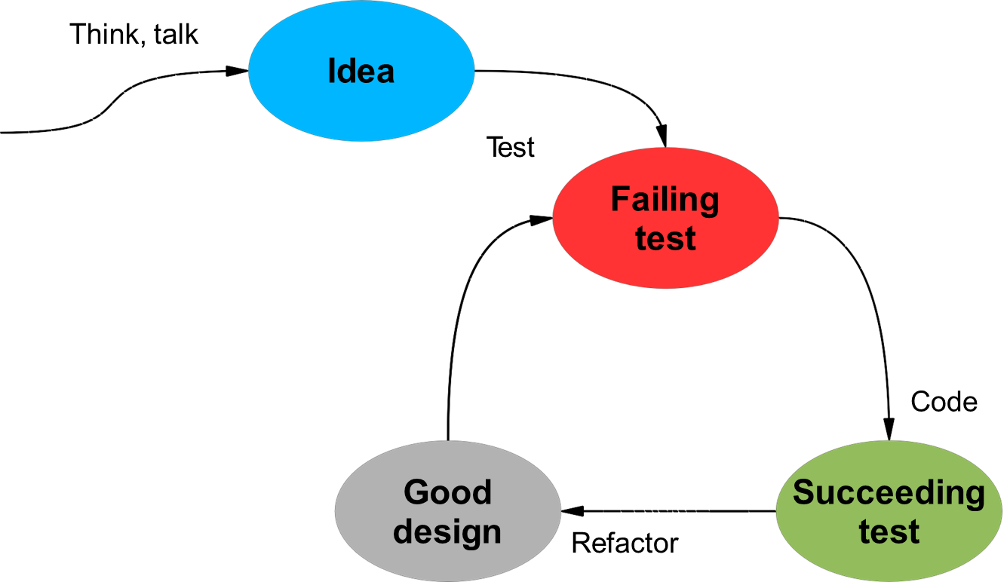
Java Bootcamp 2018 - Class 8: Testing
TDD

Slide 23
Java Bootcamp 2018 - Class 8: Testing
TDD - Test Driven Development
Approach for developing software by writing tests before writing the code being tested
Write little test
Refactor
Watch test fail
Get test pass

Slide 24
Java Bootcamp 2018 - Class 8: Testing
TDD - Test Driven Development
Facilitates software design
Express software behaviour
Documents the code

Slide 25
Java Bootcamp 2018 - Class 8: Testing
TDD - Test Driven Development
Unit testing → a form of TDD
Meets developer’s expectations for the code behaviour
Fragile → to coupled to the implementation
Should meet user’s expectations

Slide 26
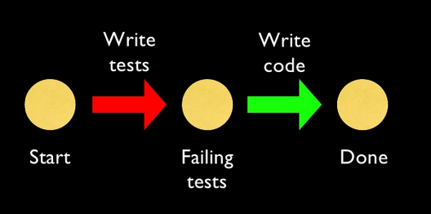
Java Bootcamp 2018 - Class 8: Testing
TDD - Test Driven Development

Slide 27
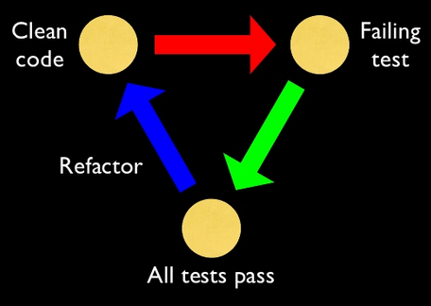
Java Bootcamp 2018 - Class 8: Testing
TDD - Test Driven Development

Slide 28
Java Bootcamp 2018 - Class 8: Testing
How can tests help improve our design?
Software design will evolve over time
A refactoring improves design without changing behaviour
Tests ensure that behaviour is not accidentally changed
Without tests, refactoring is scary
and with no refactoring, the design decays over time
With tests, we have the courage to refactor
we continually keep our design healthy

Slide 29
Java Bootcamp 2018 - Class 8: Testing
Are we wasting developer time writing tests?
NO
Time spent writing tests is not taken from time spent coding
The cost of a bug keeps increasing until we fix it
Find bugs faster
Avoid spending time testing again
Maintainability
Scalability

Slide 30
Java Bootcamp 2018 - Class 8: Testing
Code coverage
Metric that can help you understand how much of your source is tested
Helps to access the quality of your test suite
<project> ... <reporting> <plugins> ... <plugin> <groupId>org.codehaus.mojo</groupId> <artifactId>cobertura-maven-plugin</artifactId> <version>2.7</version> </plugin> </plugins> </reporting> </project>

Slide 31
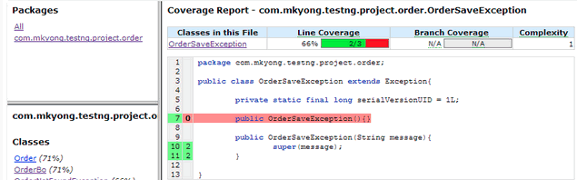
Java Bootcamp 2018 - Class 8: Testing
Code coverage - Cobertura
$ mvn cobertura:cobertura
Will generate the Cobertura code coverage report at ${project}/target/site/cobertura/index.html.

Slide 32
Java Bootcamp 2018 - Class 8: Testing
Code coverage - Percentage
What percentage should I aim for?
No silver bullet
A high percentage could still be problematic if critical parts are not being tested
Generally, 80% is a good goal to aim for.

Slide 33
Java Bootcamp 2018 - Class 8: Testing
Example
public class FlightRestControllerTest extends EasyMockSupport {
@TestSubject
FlightRestController flightRestController;
@Mock
private FlightService flightService;
@Before
public void setUp(){
flightRestController = new FlightRestController();
}
@Test
public void testAddFlight(){
resetAll();
Flight flight = new Flight(“bsas”, “madrid”);
Flight result = new Flight(“bsas”, “madrid”);
result.setId(1);
expect(flightService.addFlight(flight)).andReturn(result);
replayAll();
flightRestController.addFlight(flight);
assertTrue(....);
verifyAll();
}
}
FlightService must be mocked
Executed before every test. Useful for resetting
Ensure everything (mock-related) is reset
Set expected behaviour from mock
If different possible scenarios, a different test should be made for each of them
Set mocks to replay state (activate)
Verify everything is behaving as expected

Slide 34
Java Bootcamp 2018 - Class 8: Testing
Example
@Test(expected = FlightNotFoundException)
public void testAddFlightFlightNotFound(){
resetAll();
Flight flight = new Flight(“bsas”, “madrid”);
expect(flightService.addFlight(flight)).andThrow(FlightNotFoundException.class);
replayAll();
flightRestController.addFlight(flight);
verifyAll();
}
}
public class FlightRestControllerTest extends EasyMockSupport {
@TestSubject
FlightRestController flightRestController;
@Mock
private FlightService flightService;
@Before
public void setUp(){
flightRestController = new FlightRestController();
}
@Test
public void testAddFlight(){
resetAll();
Flight flight = new Flight(“bsas”, “madrid”);
Flight expected = new Flight(“bsas”, “madrid”);
expected.setId(1);
expect(flightService.addFlight(flight)).andReturn(result);
replayAll();
Flight result = flightRestController.addFlight(flight);
assertEquals(result, expected);
verifyAll();
}
}
Can expect an exception
Can record the throwing of an exception

Slide 35

Java Bootcamp 2018 - Class 8: Testing
Quote
“Testing shows the presence, not the absence of bugs”
Edsger W. Dijkstra

Slide 36
Java Bootcamp 2018 - Class 8: Testing
Any questions?

